Slide 1


SAP UI5 & FIORI with OData TRAINING
Anubhav Oberoy
Day – 28

Slide 2

Agenda – Day 28
Create App from external Service
Add bullet Chart inside table
Working with In-app Extensibility

Slide 3
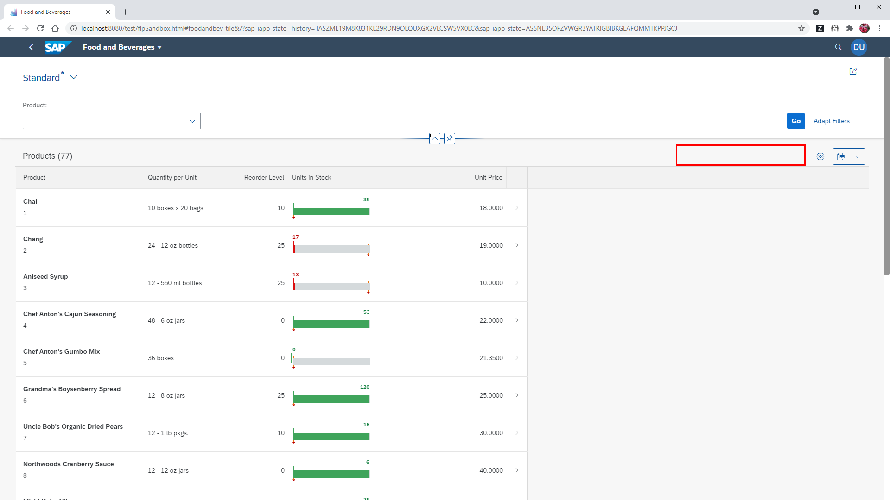
Build LRP from External Service
https://services.odata.org/V2/Northwind/Northwind.svc/

Slide 4
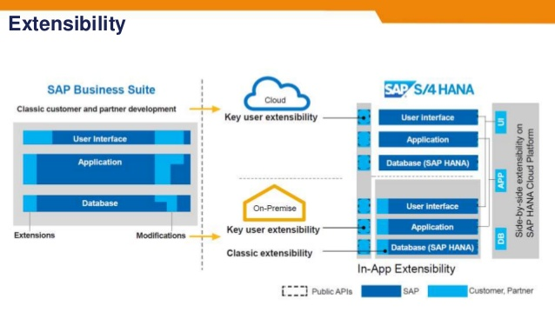

Slide 5
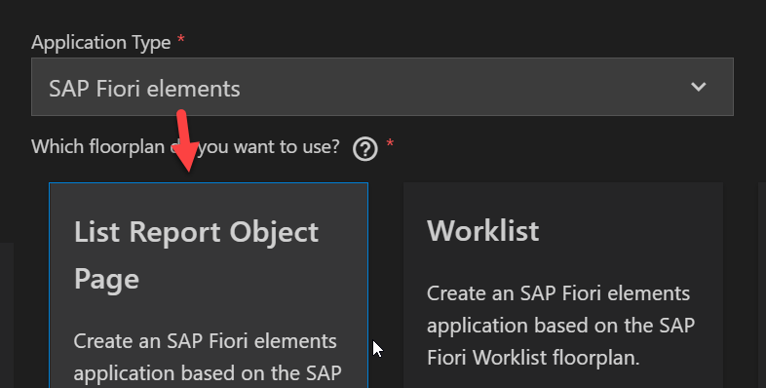
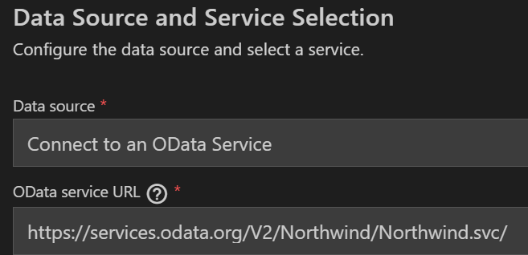
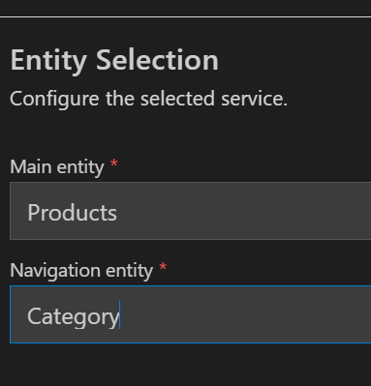

Slide 8

End of Day 28

Slide 9

Questions

Slide 10

Anubhav Oberoy

Slide 11


We’re committed to empower you to be
Most Desirable Resource
through powerful training solutions.
We build the workforce of the future.
280+
Corporate Clients
30,000+
Learners Trained
28000+
Learners Placed
FREE WEBINARS
Sign up for free webinars with industry experts every fortnight!
Enroll Now!
Contact us today!
https://anubhavtrainings.com/

Slide 12




More from AnubhavTrainings.com

Slide 13
Title
Content

